Slide 1
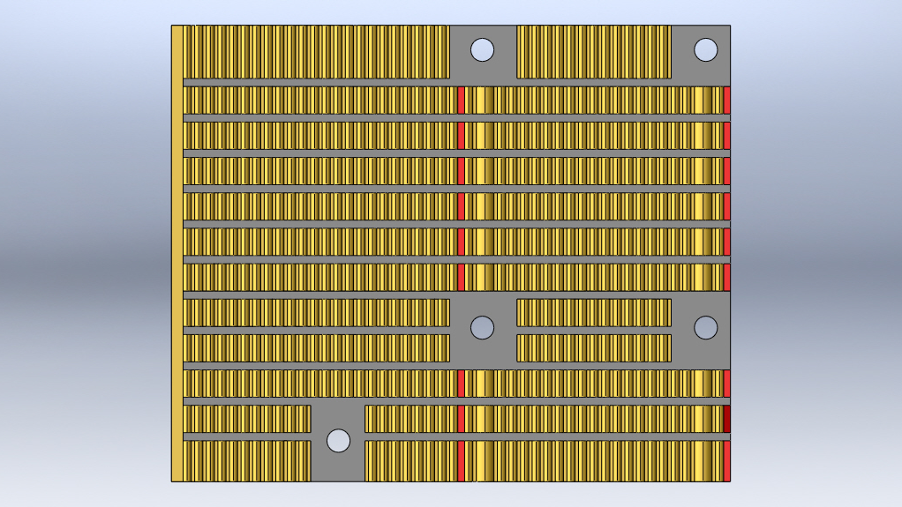
top
82mm
3.4mm
67mm

